Slide 1
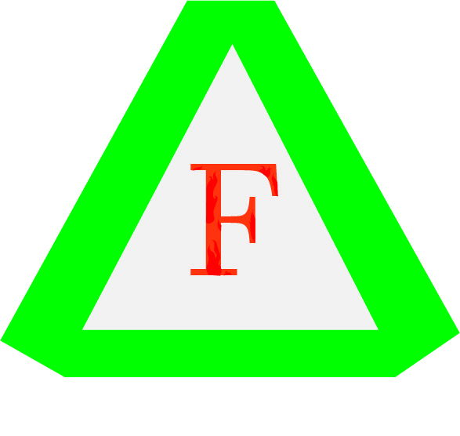
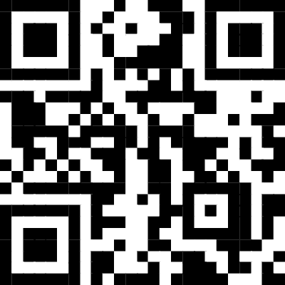
Firepro Technologies & Engineered Systems Company Profile
UNIT F G/F EC Nicolas Residences, 8223 F.YABUT Circle Guadalupe Nuevo, Makati City, Metro Manila
Tel: 87885045 Tel/Fax: 76219846
Cellphone Number: 09162209637/09205696440
Email: fireprotechnologies@yahoo.com, fireprotechnologies@hotmail.com, fireprotechnologies.sales@gmail.com
FB Page

Slide 2
Background
Background:
The company founder has 16 years’ experience in marketing Fire Protection and Security systems.
In June 2009, the new company Firepro Technologies and Engineered Systems was officially registered at the Department of Trade and Industry (DTI)
At present, Firepro Technologies and Engineered Systems is the Authorized Dealer of some of the leading manufacturer of Fire Detection, Fire Suppression and Security Systems from United Kingdom, USA, Spain, China, Malaysia, Poland and Taiwan.

Slide 3
Key Offerings:
Access Control/Intrusion Systems
· Satel Intelligent Security Solutions
Energy and Building Management System
• Intellergy/PowerWise System
CCTV Monitoring Systems
• Dahua Technology
• LS Vision Technology
Other Specialty Works:
• Design of Sanitary, Water, Gas and Fire Protection services, Piping design for mining and petrochemical industry
• Perform calculations for heating, ventilation and air conditioning systems using Carrier/CAMEL software.
• Sizing of HVAC equipment such as ACCU, FCU, AHU, SF, EF, Heaters and associated air ducts and piping.
• Perform thermal and energy analysis for residential establishments using NatHERS (Nationwide House Energy Rating Scheme), BERS, and FirstRate5.

Slide 4
Fire Alarm System
· KENTEC Electronics Limited
· Linear Heat Detection
· ZETA Alarm Systems
- UL Listed Velocity Addressable Fire Alarm
- European/LPCB Conventional & Addressable Fire Alarm
· XTRALIS VESDA Aspirating Detection
· Xtralis ICAM Aspirating Detection
Fire Suppression System/Fire Protection System
• AirFire
· SR200/HFC-227ea Fire Suppression
· STREAMEX FK-5-1-12 Fire Suppression
· Inert Gas Fire Suppression
· HD Fire Deluge System/Sprinkler System
• Master Clock Systems
Sapling Synchronized Clock System

